Slide 1

Time management
Jimmy Jose
S2 CS – A
Roll No: 32

Slide 2
What is time management (TM)
Time Management refers to managing
time effectively so that the right time
is allocated to the right activity.

Slide 3
Why do we need TM
To save time
To reduce stress
To function effectively
To increase our work output
To have more control over our job responsibilities.

Slide 4
How to use time effectively
Effective Planning
Setting goals and objectives
Setting deadlines
Delegation of responsibilities
Prioritizing activities as per their importance
Spending the right time on the right activity

Slide 5
The process of TM starts with-
Cost your time
Making activity logs
Goal setting
Planning
Prioritizing
Scheduling

Slide 6
Use your time wisely
Time is what we want most, but what we use worst.
William Penn
The common man is not concerned about the passage of time, the man of talent is driven by it.
Schopenhauer
The key is in not spending time, but in investing it.
Stephen R. Covey
Make use of time, let not advantage slip.
William Shakespeare

Slide 7
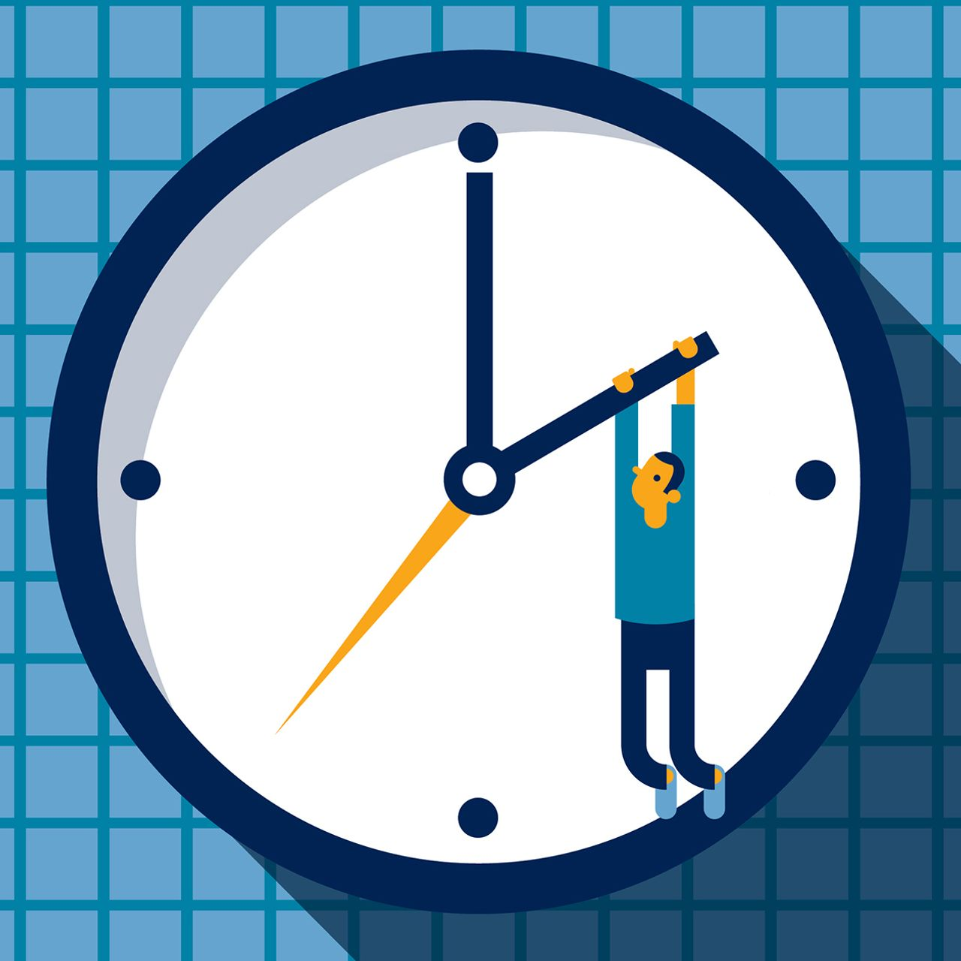
Achieve your goals
Be your own judge and your own motivator
Make Time Management
your tool for success.

Slide 8


